Slide 1
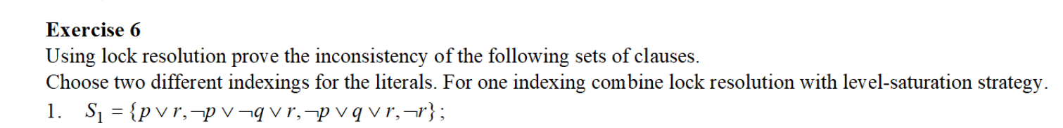
Problem statement

Slide 2
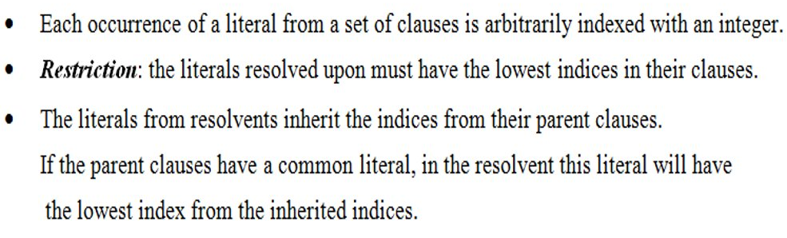
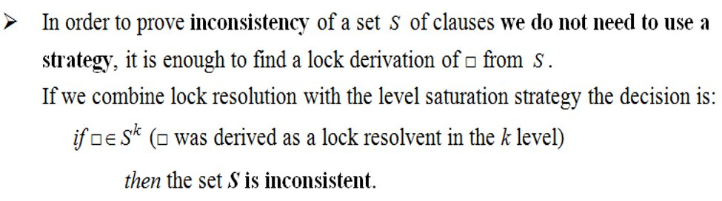
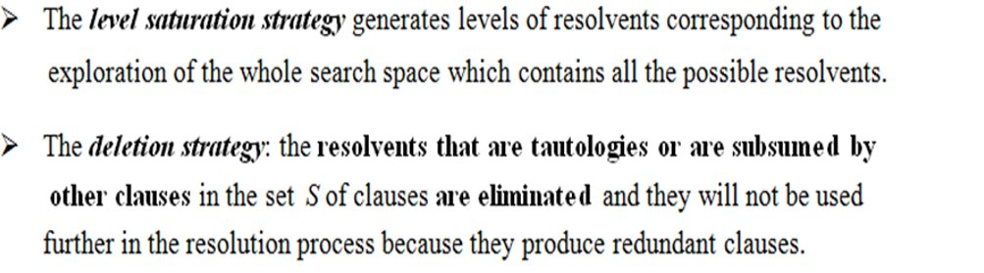
Theoretical results
Lock resolution

Slide 3
Lock resolution + level-saturation strategy
S1 = {p∨r, ¬p∨¬q∨r, ¬p∨q∨r, ¬r }
The literals from the clauses are indexed as follows:
C₁ = ₍₁₎ p∨₍₂₎r
C₂ =₍₃₎ ¬p∨₍₄₎ ¬q∨₍₅₎ r
C₃ = ₍₆₎ ¬p∨₍₇₎ q∨₍₈₎ r
C₄ = ₍₉₎ ¬r
S⁰ = S = {C₁, C₂, C₃, C₄}
C₅ = Res_{r}^{lock}(C₁, C₂) = ₍₄₎¬q∨₍₂₎ r
C₆ = Res_{r}^{lock}(C₁, C₃) = ₍₇₎ q∨₍₂₎ r
S² = {C₄, C₅, C₆}
=> S is inconsistent
S³ = {C₄, C₇}
C₇ = Res_{r}^{lock}(C₅, C₆) = r
C₈ = Res_{r}^{lock}(C₄, C₇) =

Slide 4
Lock resolution + no strategy
S1 = {p∨r, ¬p∨¬q∨r, ¬p∨q∨r, ¬r }
The literals from the clauses are indexed as follows:
C₁ = ₍₁₎ p∨₍₂₎r
C₂ =₍₄₎ ¬p∨₍₅₎ ¬q∨₍₃₎ r
C₃ = ₍₇₎ ¬p∨₍₈₎ q∨₍₆₎ r
C₄ = ₍₉₎ ¬r
The derivation of the empty clause:
C’₅ = Res_{r}^{lock}(C₂, C₃) = ₍₄₎ ¬p∨ ₍₃₎ r
C’₆ = Res_{r}^{lock}(C₁, C’₅) = ₍₂₎ r
C’₇ = Res_{r}^{lock}(C₄, C’₆) =
=> S is inconsistent

Slide 5
Conclusion
Using lock resolution and two different indexings for the literals, we proved the inconsistency of the S1
Abrudan Rebeca-Rafaela

